Slide 1

NSG Pilkington – University of Liverpool Machine Learning Project: 27/05/2021
Dr. Peter Green
Diego Echeverria
Sarini Jayasinghe
Risk Institute,
School of Engineering

Slide 2
Today
Content:
Training data selection
Clustering by product type
Identifying non-furnace faults using DB-SCAN
Upskilling:
Linear regression
How do we learn ‘online’?
What actually is a Neural Network?
What is a Gaussian Process?
How does PCA work?

Slide 3
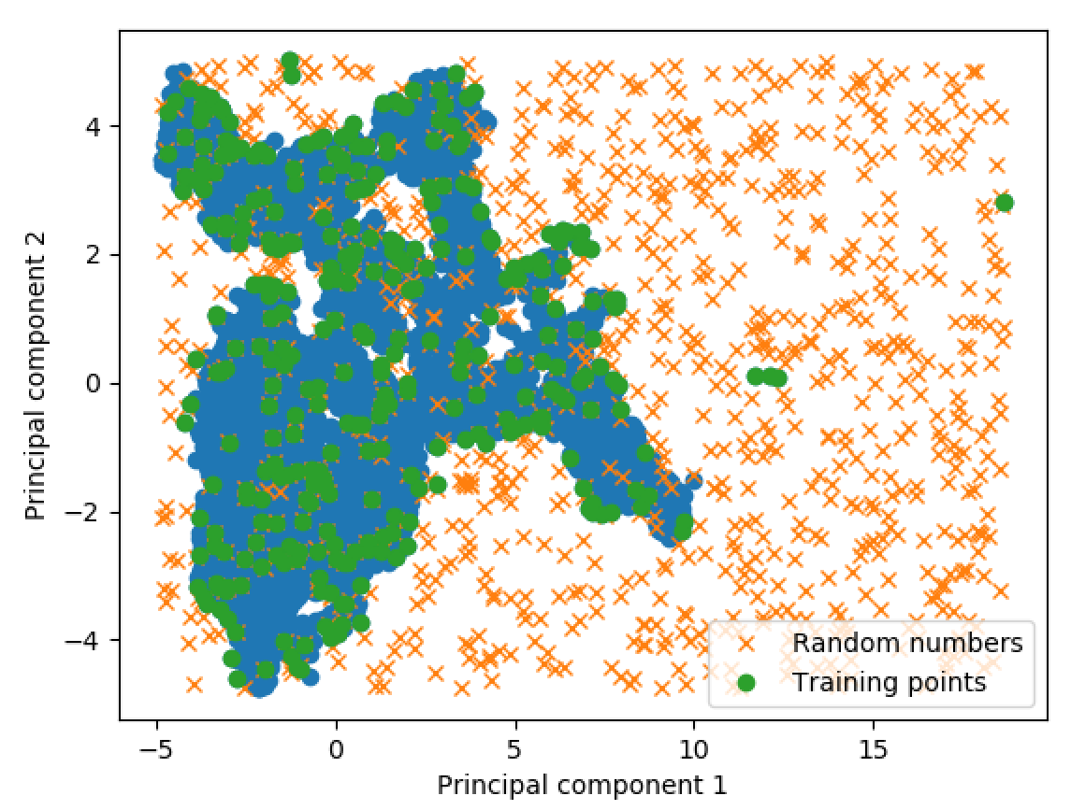
Training Data Selection
1000 random samples lead to around 300 unique training points (in this case).
Previously we were using 5000 training samples, all taken from the beginning of the period.

Slide 4
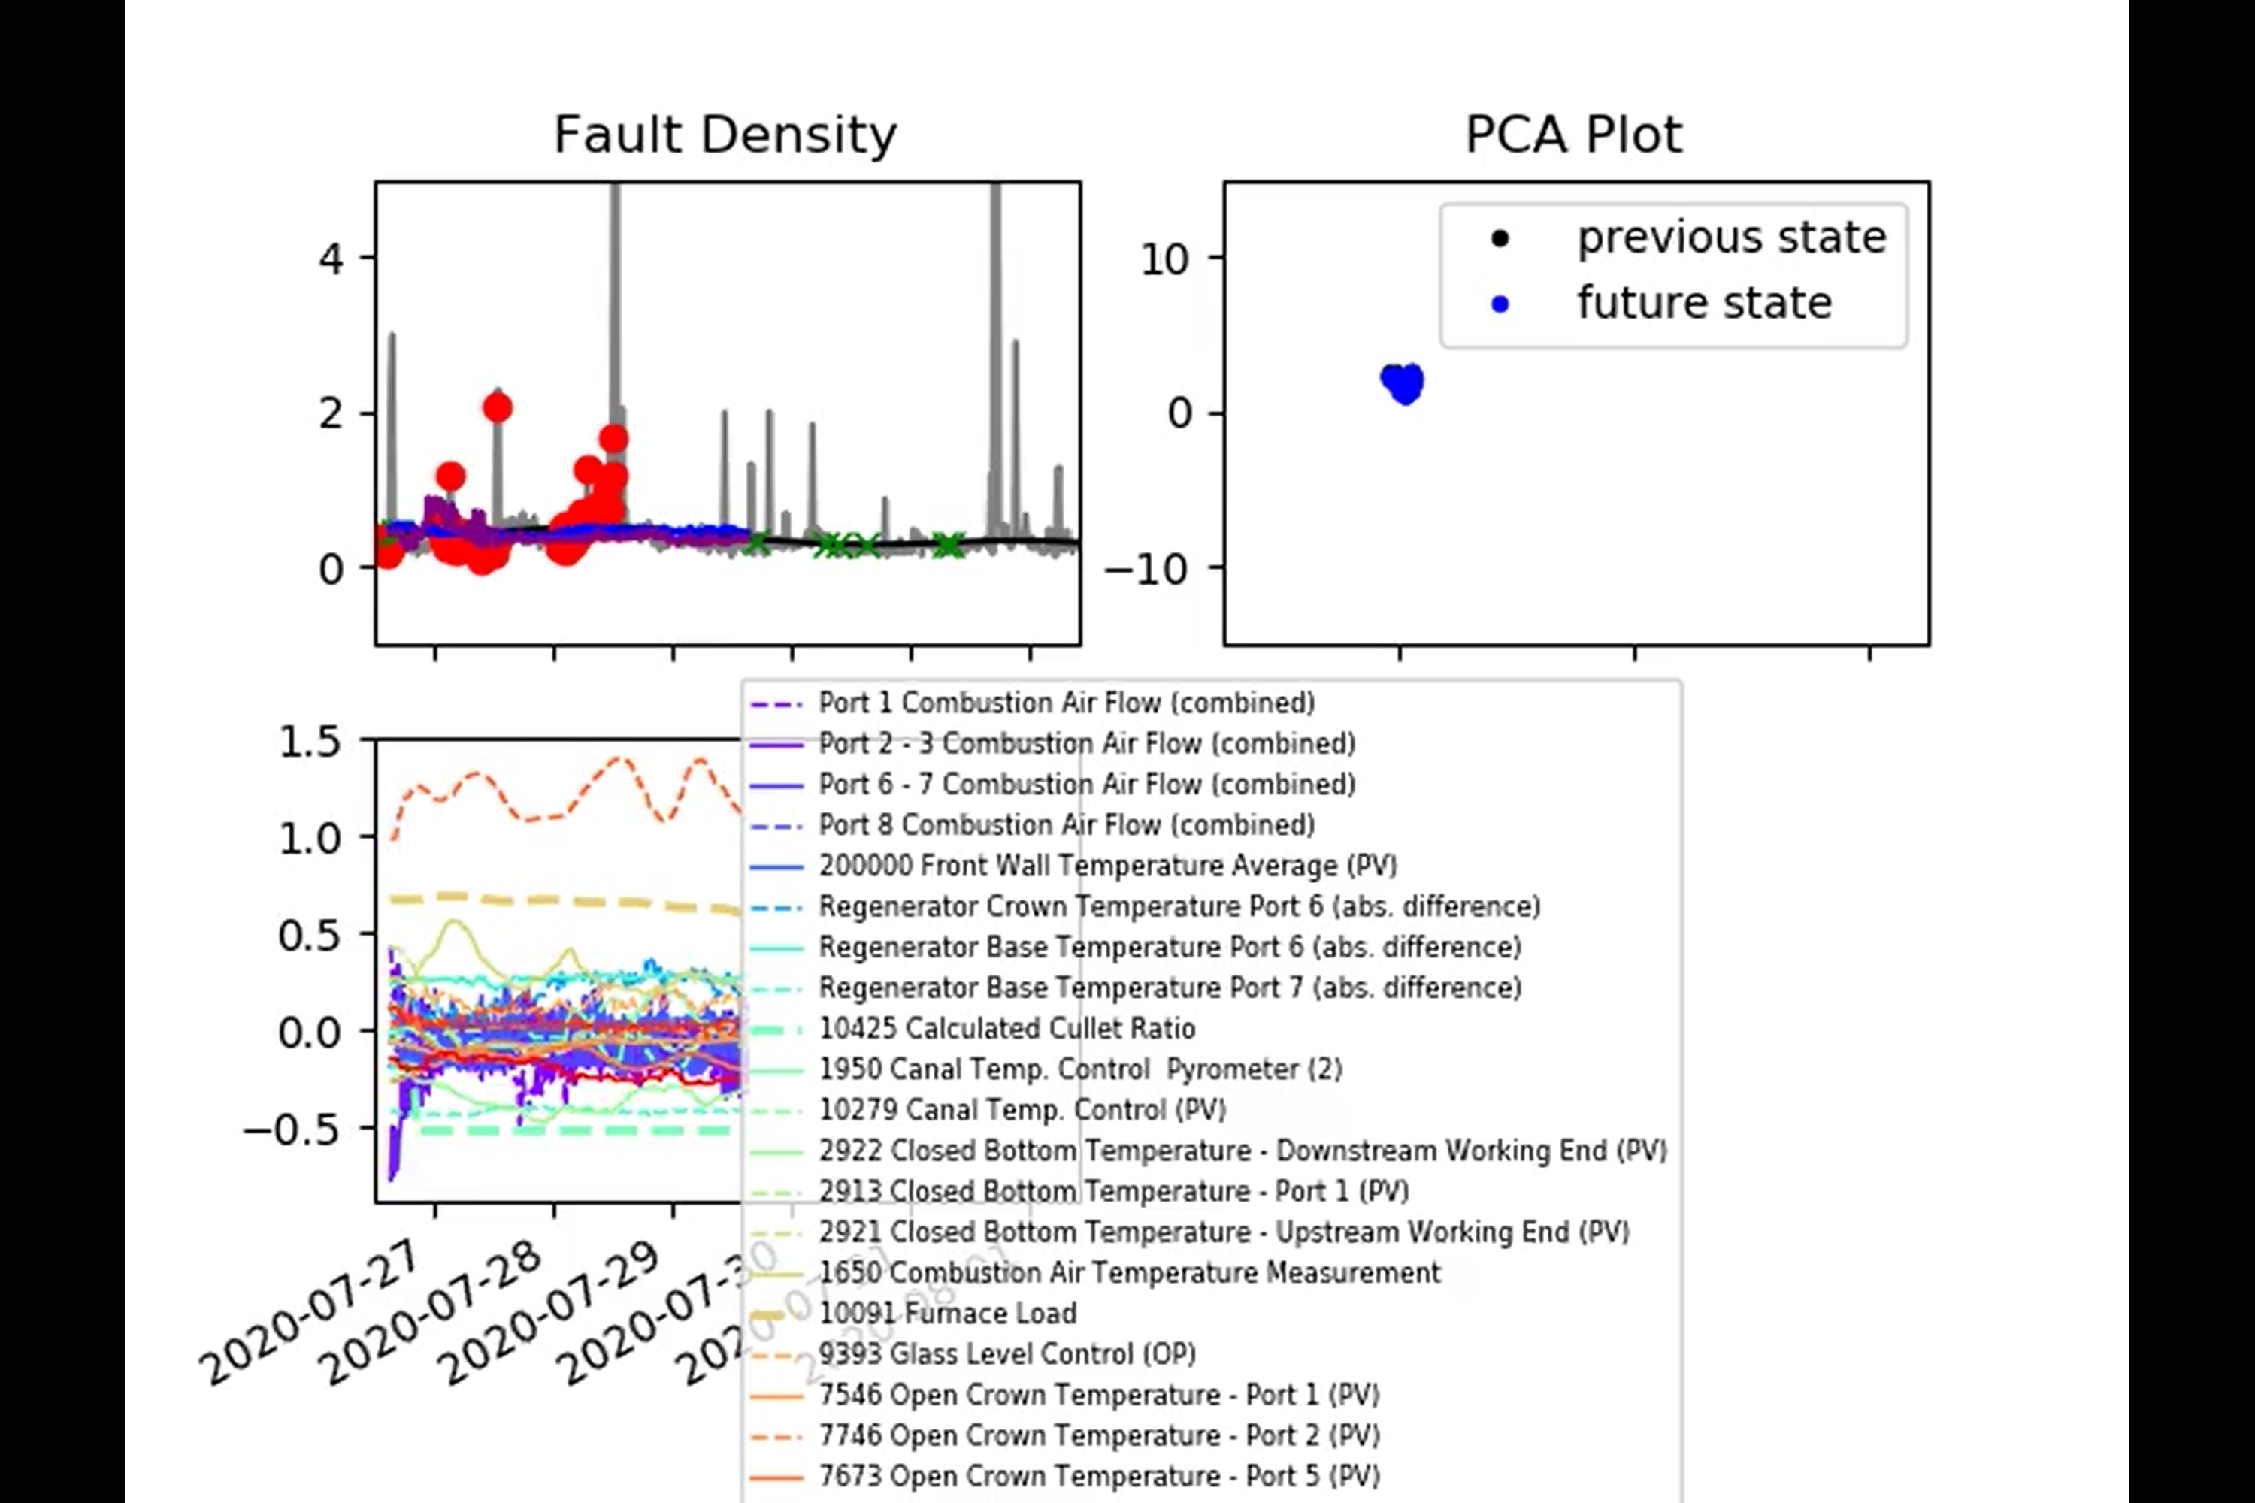
Training Data Selection
Training data now represented as green crosses
Coating periods are still red circles
Linear regression: Blue
Artificial Neural Network: Purple
Results on the SharePoint: 2021-05-25_results.mp4

Slide 5
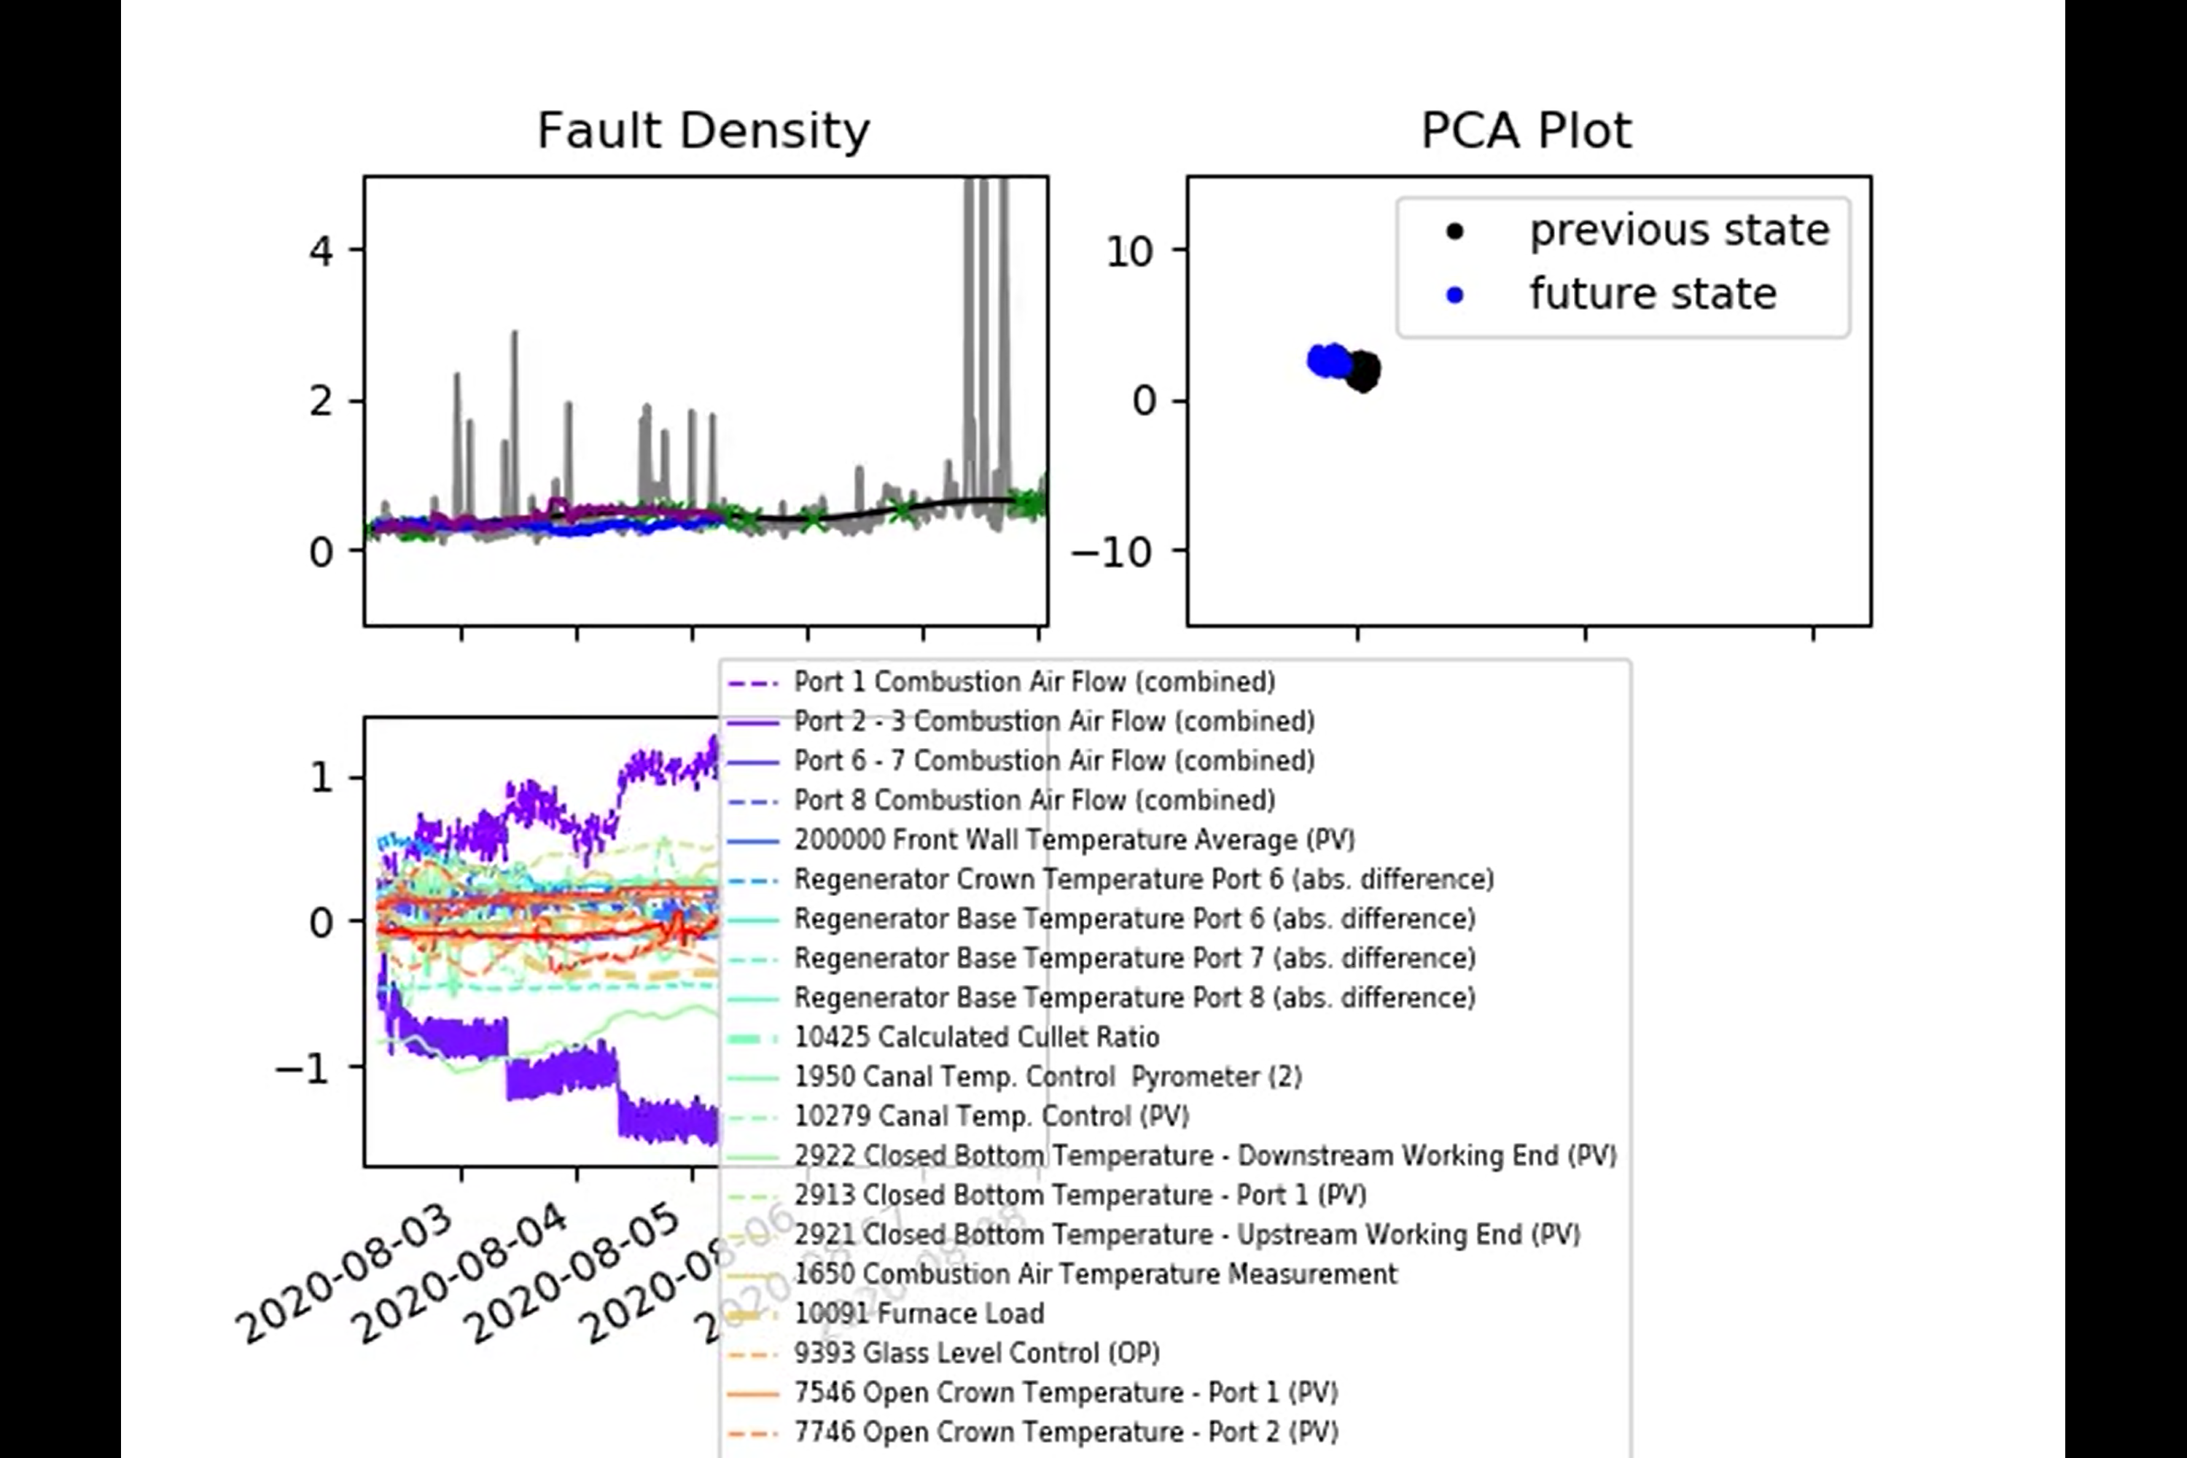
Training Data Selection

Slide 6
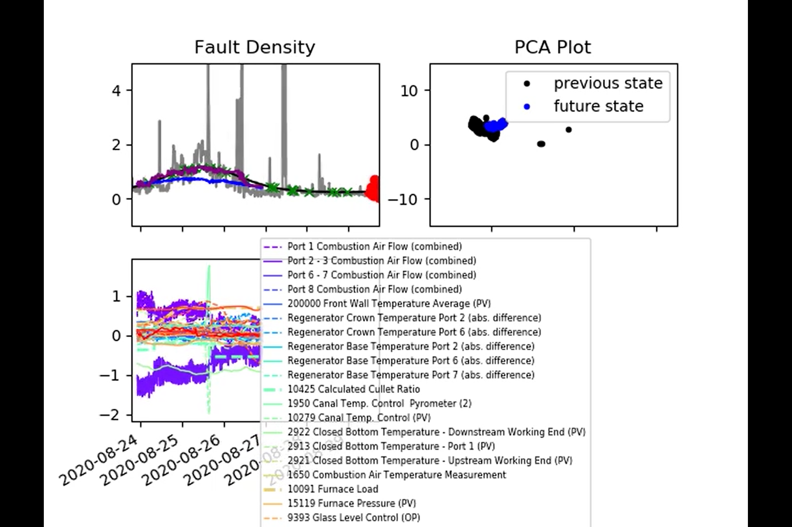
Training Data Selection

Slide 7
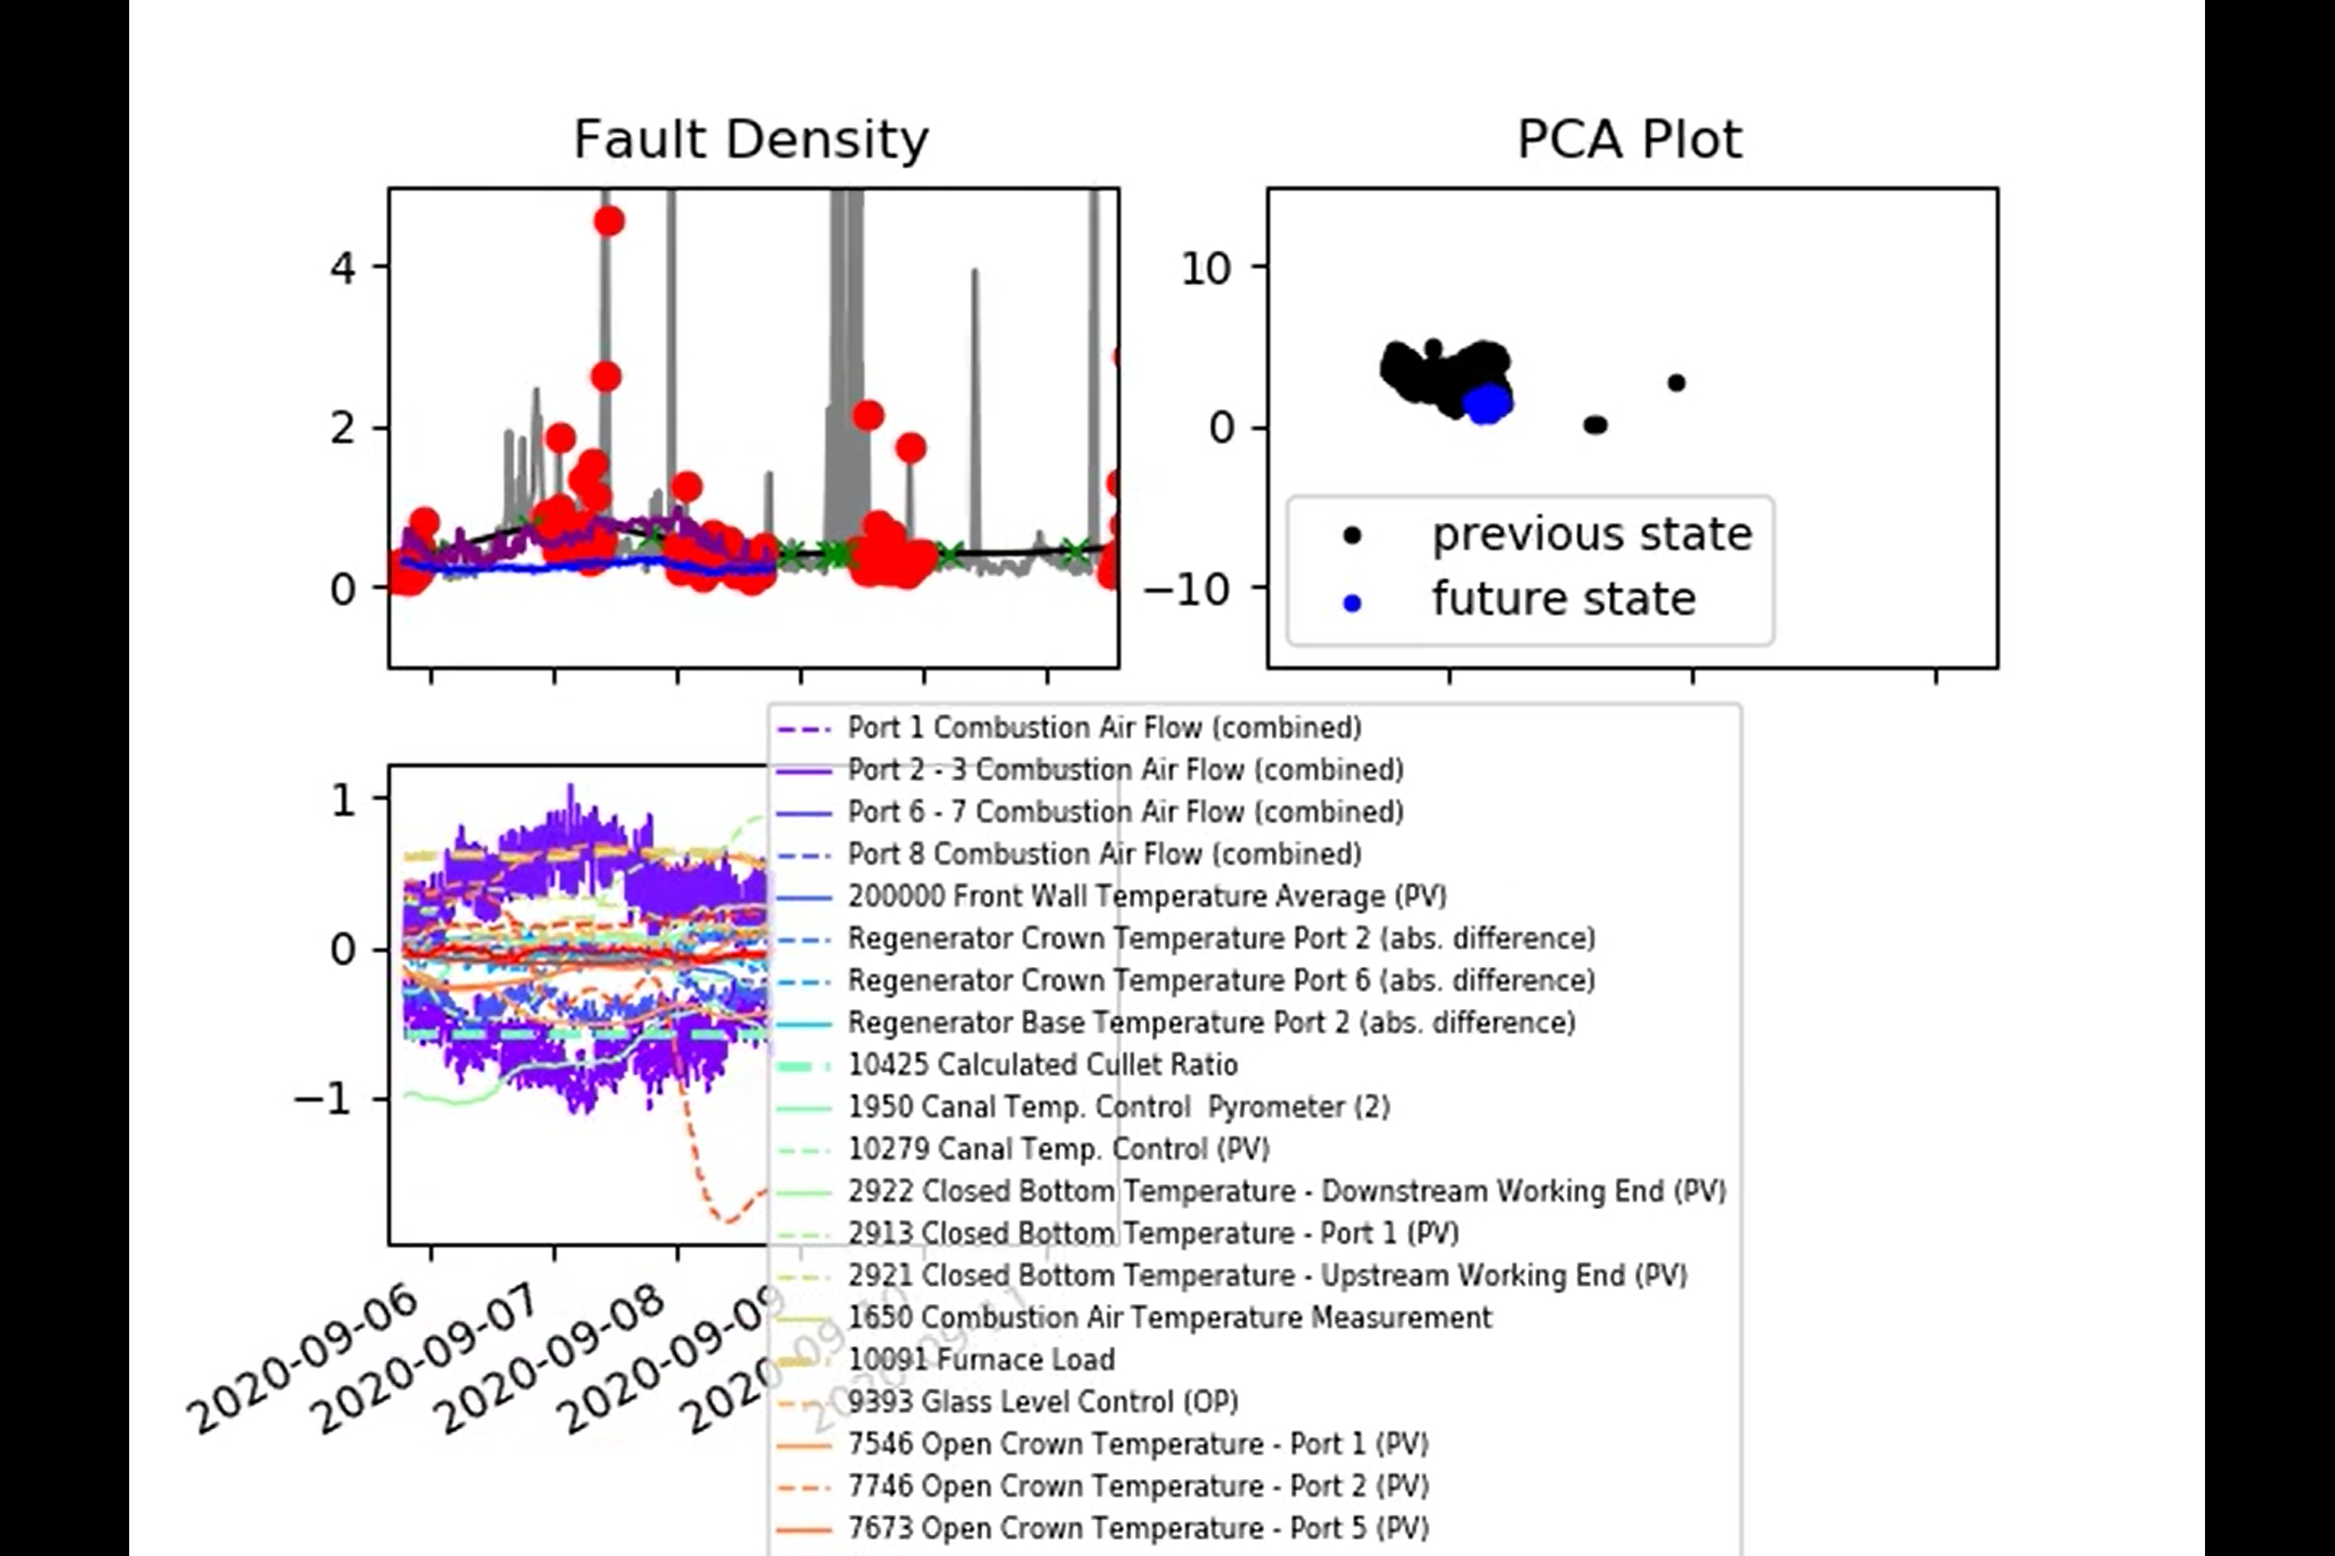
Training Data Selection

Slide 8
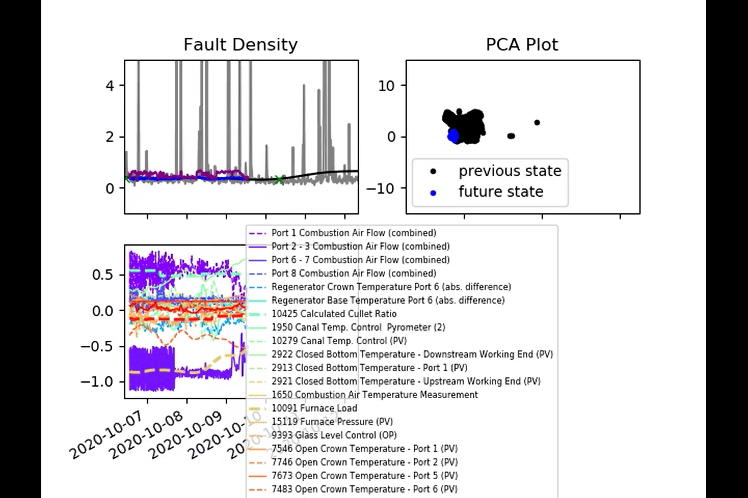
Training Data Selection

Slide 9
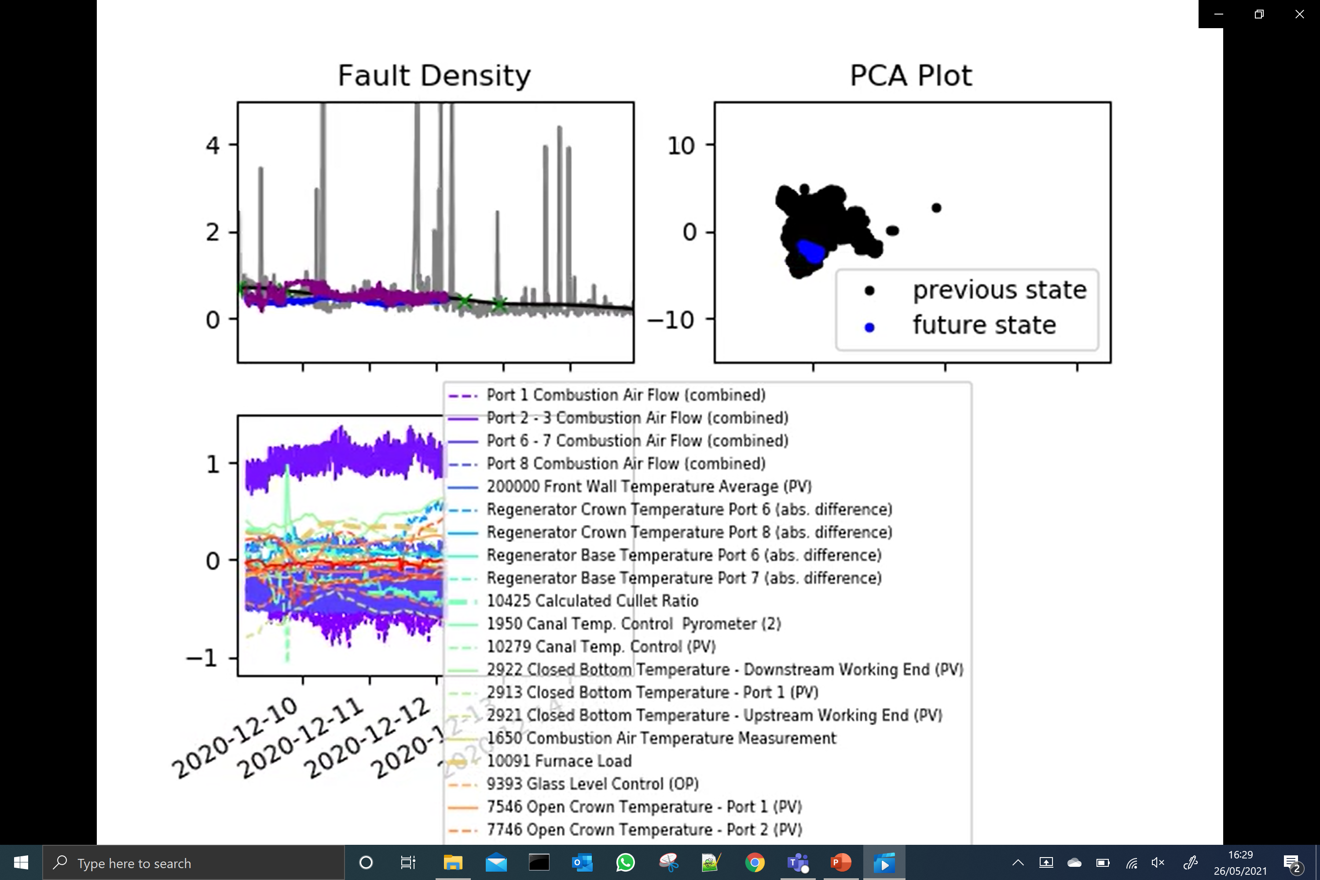
Training Data Selection

Slide 10
Training Data Selection
Conclusions and Next Steps
Much less training data than before but, in general, we are able to get better performance (particularly from the ANN).
This lends weight to the hypothesis that a nonlinear model can work well over this region, so long as the training data covers the ‘state space’ (i.e. the PCA plot).
Obvious next steps:
Input selection
Tune time lags
We can also try fitting a Gaussian Process (GP) to the same data (giving a third option!)
The GP should be able to outperform the ANN. It also:
Performs uncertainty quantification
Should ‘easily’ allow us to perform input selection (If we don’t have memory issues! We don’t know yet…)
Renaming inputs according to Matt’s email – will be prioritised next week.

Slide 11
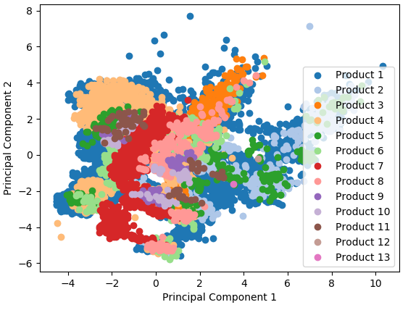
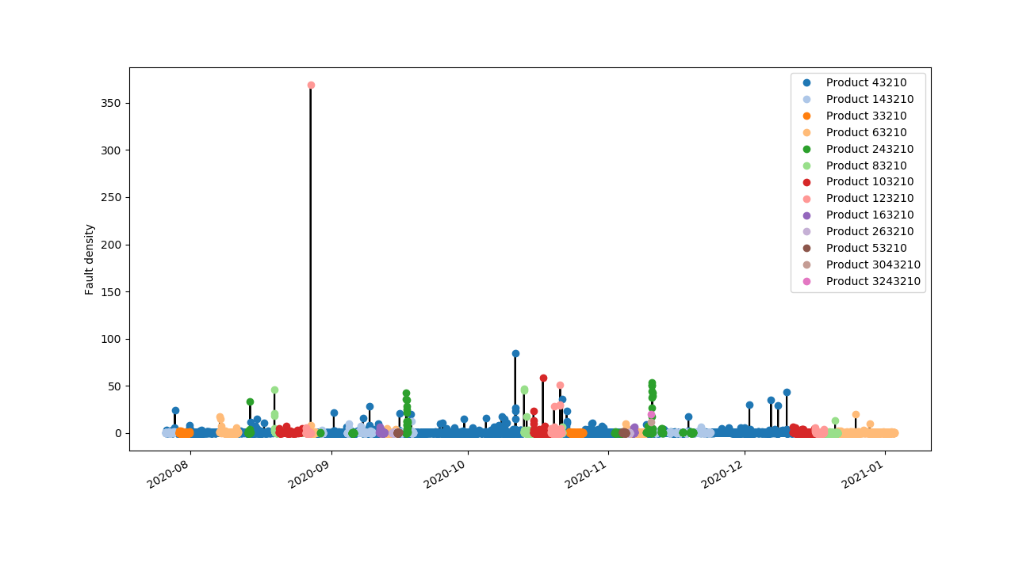
Clustering by product type
PCA plot drawn for reduced input set without combined signals

Slide 12
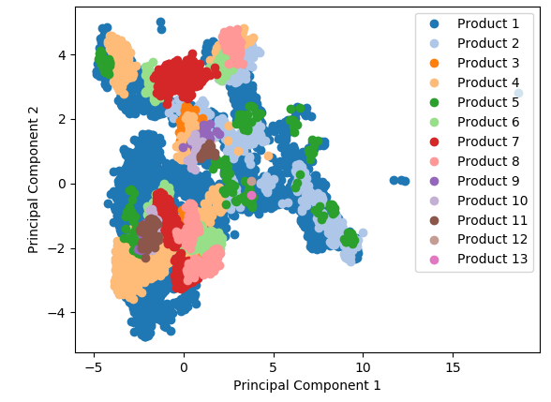
Clustering by product type
PCA plot drawn for reduced input set with combined signals

Slide 13
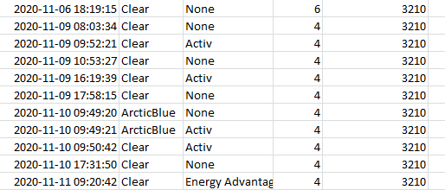
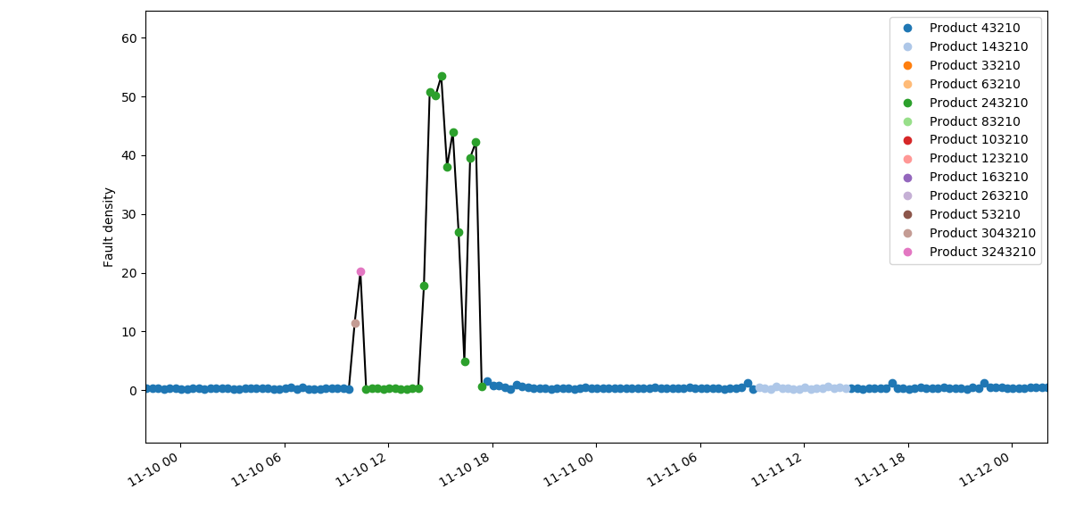
Clustering by product type
Product: `BodyTint’ `LocalDescription’ `Thickness’ `PlannedRibbonWidth’
2 products within few minutes
BodyTint | LocalDescription
Clear = 0 | None = 0
White = 1 | Energy Advantage = 1
OW = 2 | Activ = 2
ArcticBlue = 3
1 (E) = 4

Slide 14
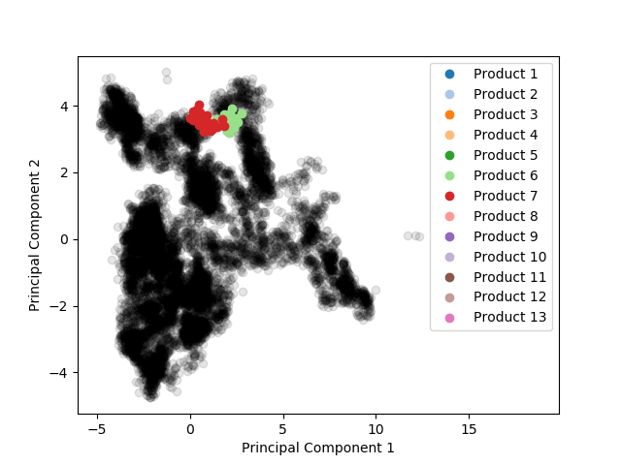
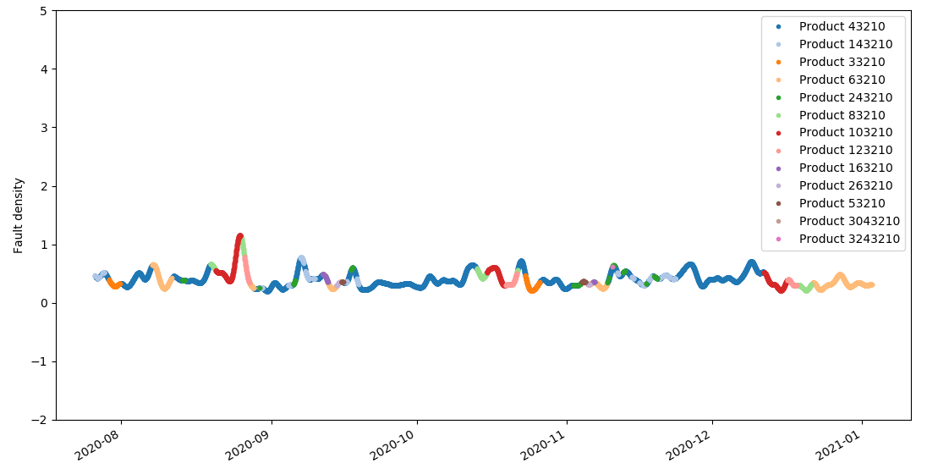
Clustering by product type
Thickness change 10 to 8
Filtered fault density = 1

Slide 15
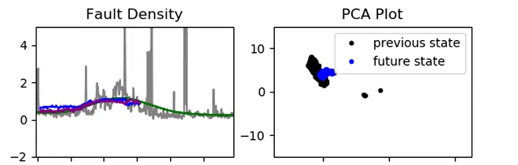
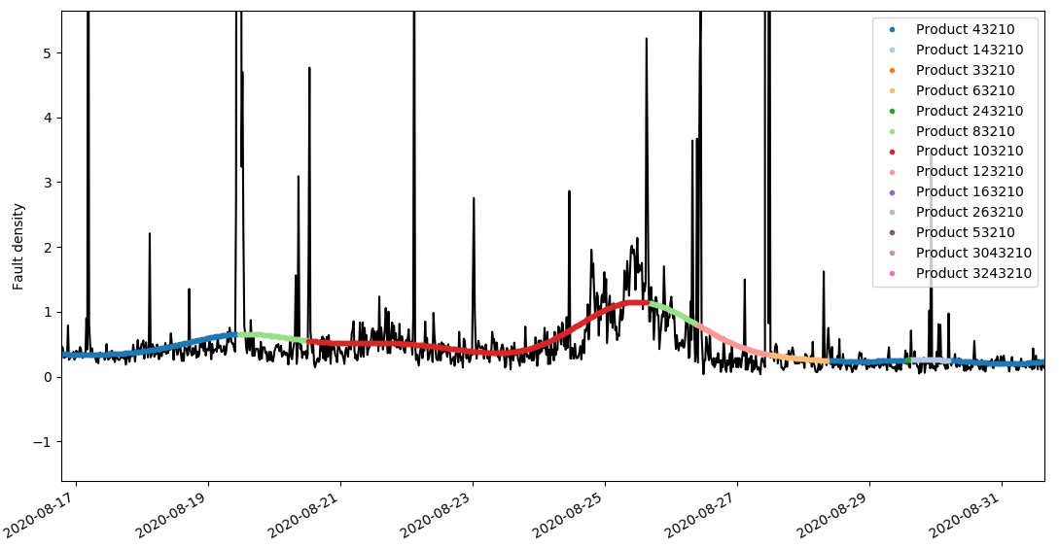
Clustering by product type
In transition to a new sub space

Slide 16
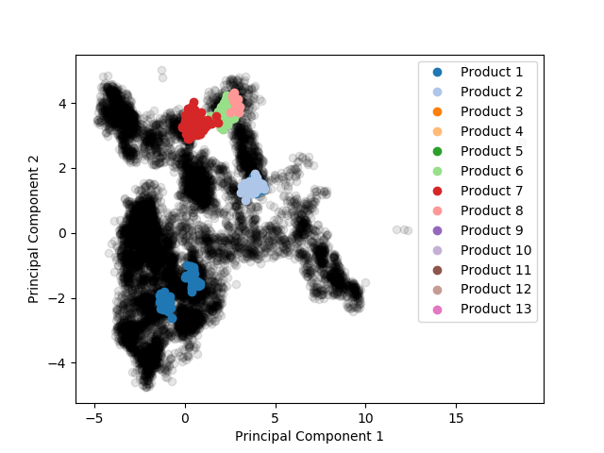
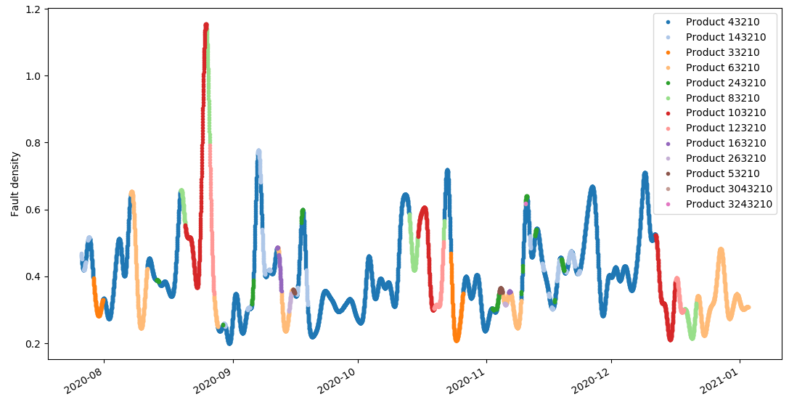
Clustering by product type
Filtered fault density = 0.7

Slide 17
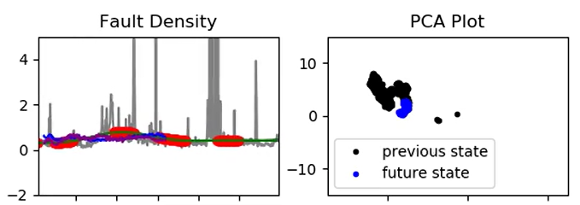
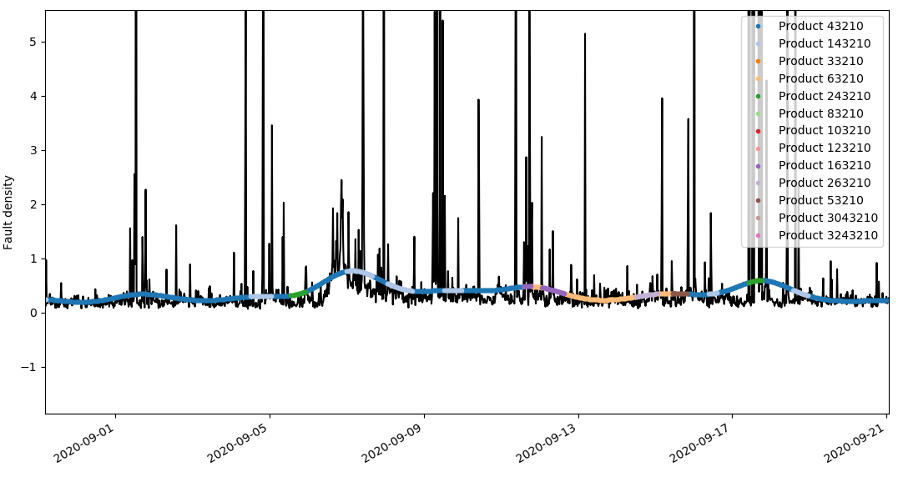
Clustering by product type
In transition to a new sub space

Slide 18
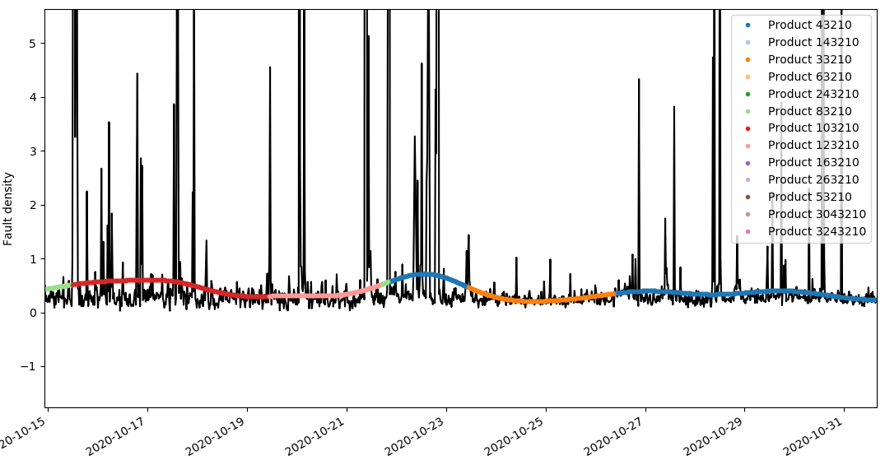
Clustering by product type
Product change

Slide 19
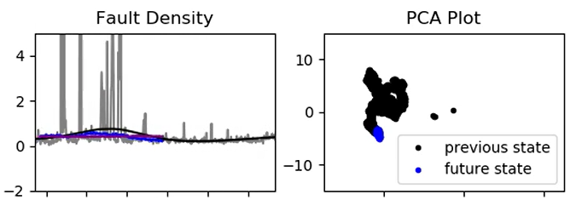
Clustering by product type
In transition to a new sub space

Slide 20
Clustering by product type
PCA plot drawn for reduced input set with combined signals

Slide 21
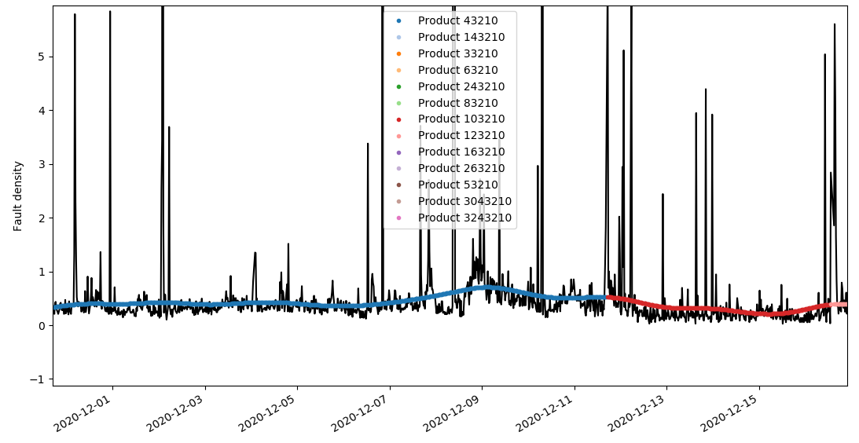
Clustering by product type

Slide 22
Identifying non-furnace faults using DBSCAN
We use the data in the “Fault Scanner Data 20190801 to 20210218” spreadsheet to resemble the glass ribbon.
x-axis: length (DateTime), y-axis: modules
Hypothesis:
The faults with a density below or equal to x = 0.9 (a parameter defined by the user) are assumed to be generated exclusively by the furnace.
The faults with a density greater than 0.9 are assumed to be generated by the furnace and non-furnace processes.

Slide 23
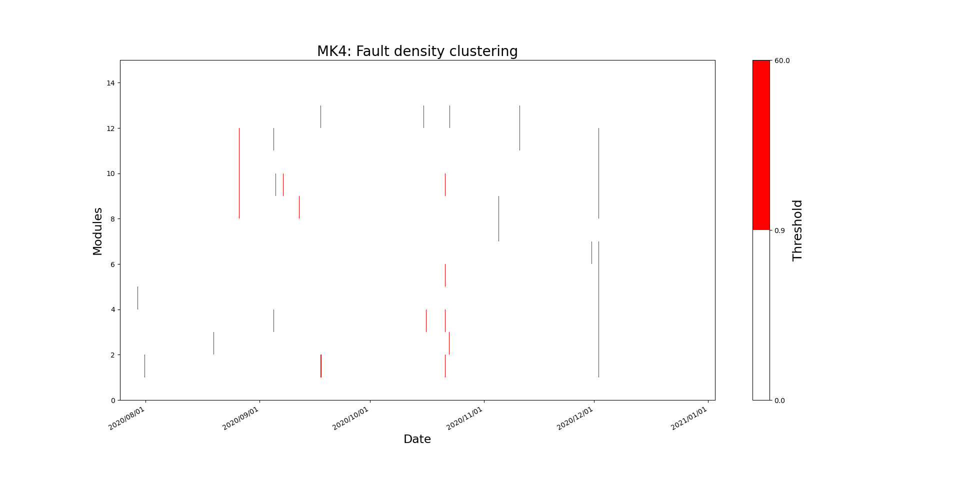
Identifying non-furnace faults using DBSCAN
Using the full data from 25 August 2020 to 03 January 2021

Slide 24
Identifying non-furnace faults using DBSCAN
Assuming that the furnace faults are randomly distributed over the glass ribbon, we aim to identify non-furnace faults using the DBSCAN clustering method.
Faults identified with a DBSCAN cluster are assumed to be generated by non-furnace processes.
If the DBSCAN method identifies data generated by noise:
It means that such points are randomly distributed across the glass ribbon.
We can associate such faults with the furnace process.

Slide 25
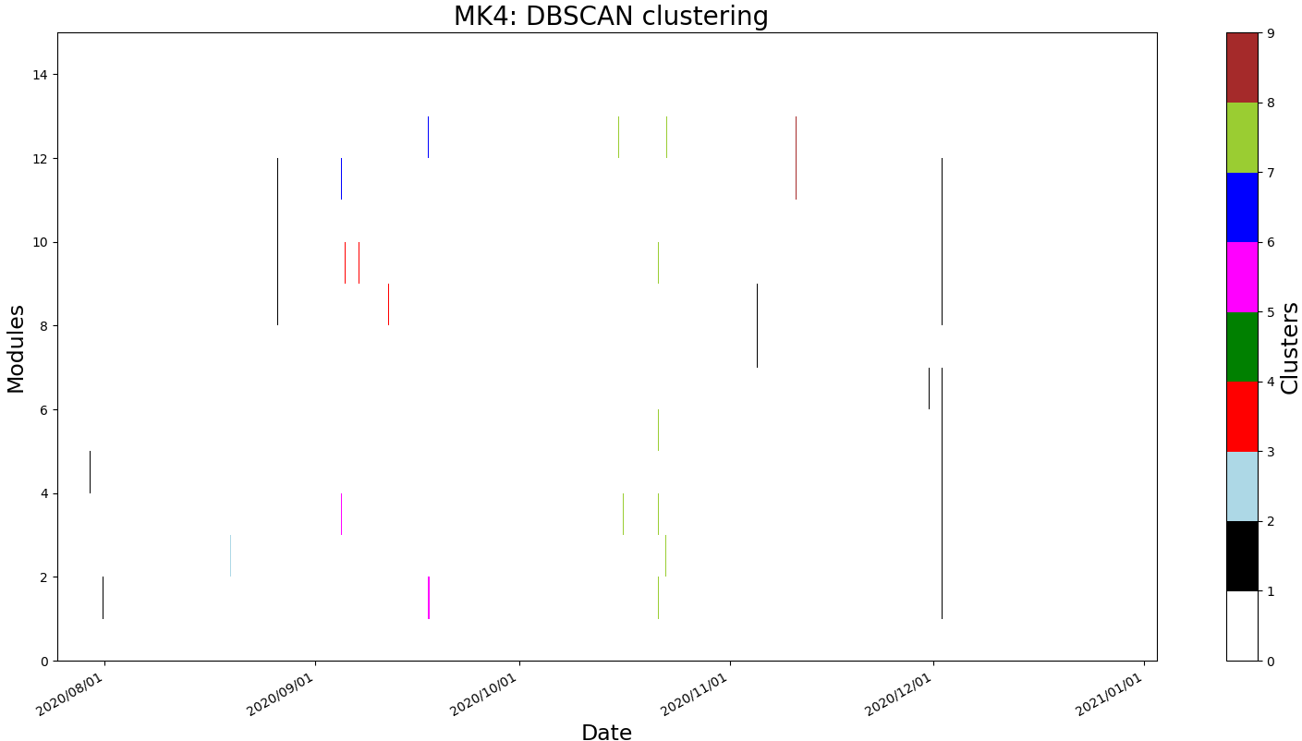
Identifying non-furnace faults using DBSCAN
N clusters: 7 N noise points: 229
Noise
FD < 0.9

Slide 26
Identifying non-furnace faults using DBSCAN
Notice that the ends of the glass ribbon only contains black points
Noise
FD < 0.9

Slide 27
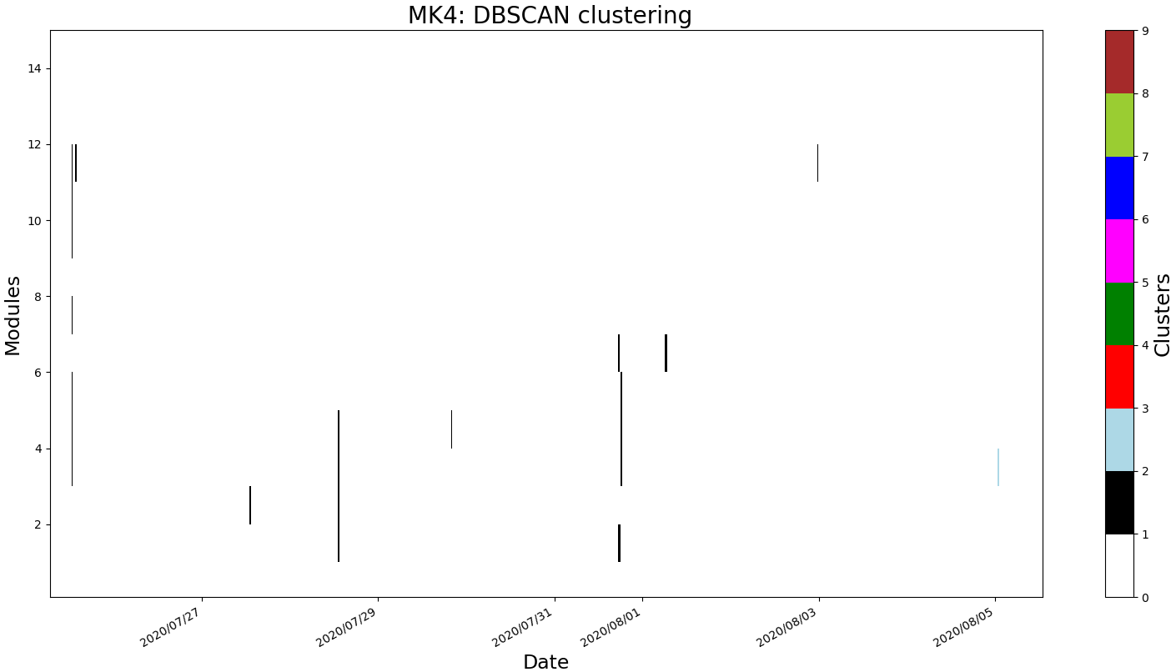
Identifying non-furnace faults using DBSCAN
Notice that the ends of the glass ribbon only contains black points
Noise
FD < 0.9

Slide 28
Identifying non-furnace faults using DBSCAN
Notice that the ends of the glass ribbon only contains black points
Noise
FD < 0.9

Slide 29

Identifying non-furnace faults using DBSCAN
Notice that the ends of the glass ribbon only contains black points
Noise
FD < 0.9

Slide 30
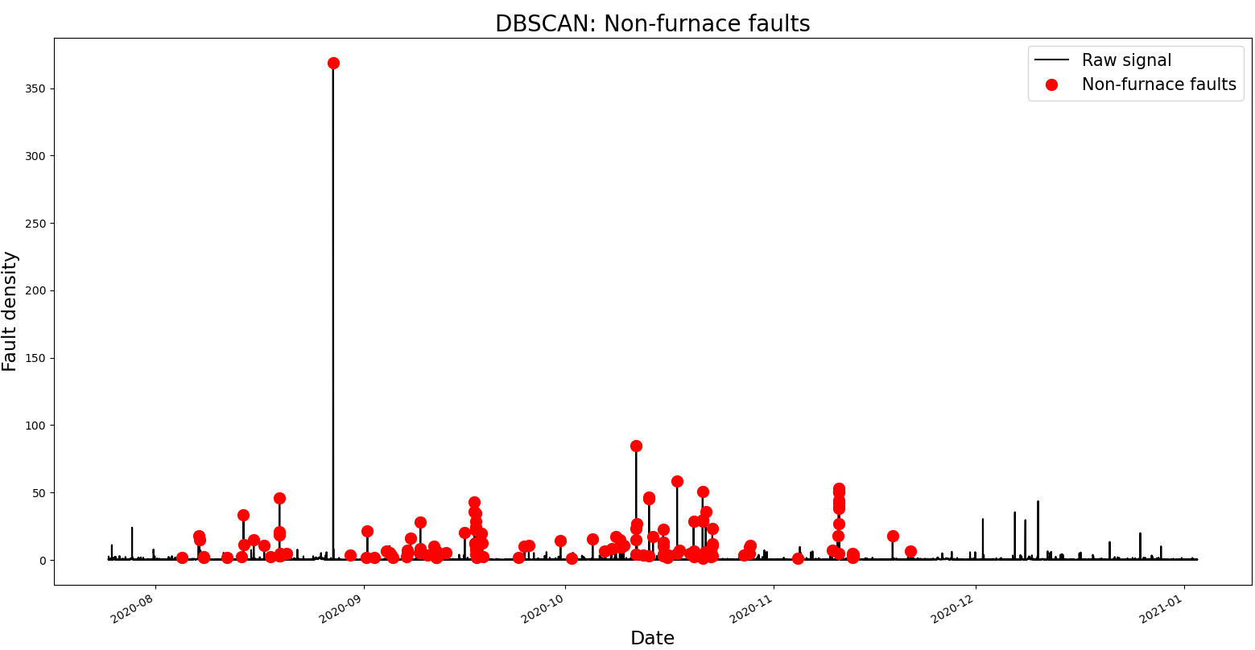
Identifying non-furnace faults using DBSCAN

Slide 31
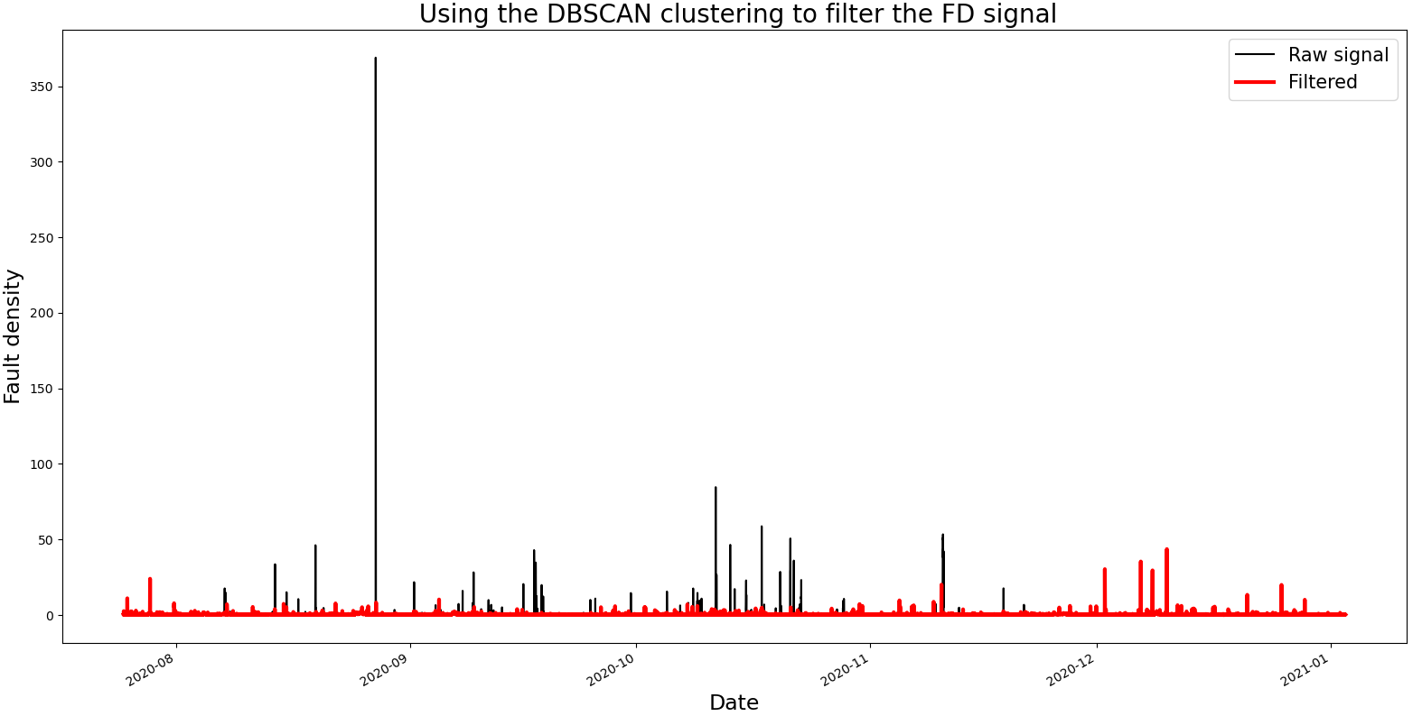
Identifying non-furnace faults using DBSCAN

Slide 32
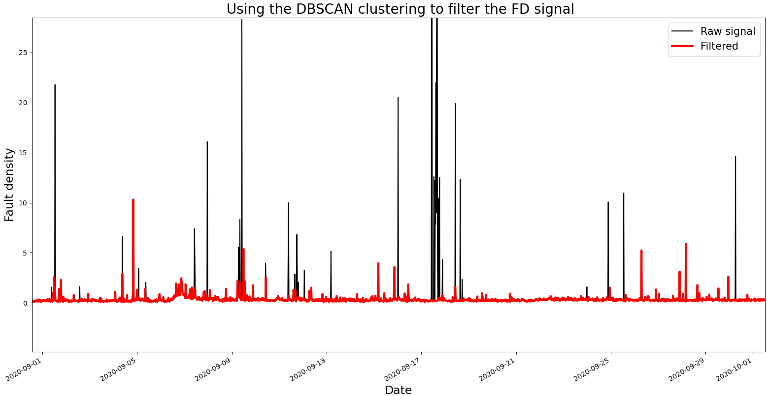
Identifying non-furnace faults using DBSCAN

Slide 33
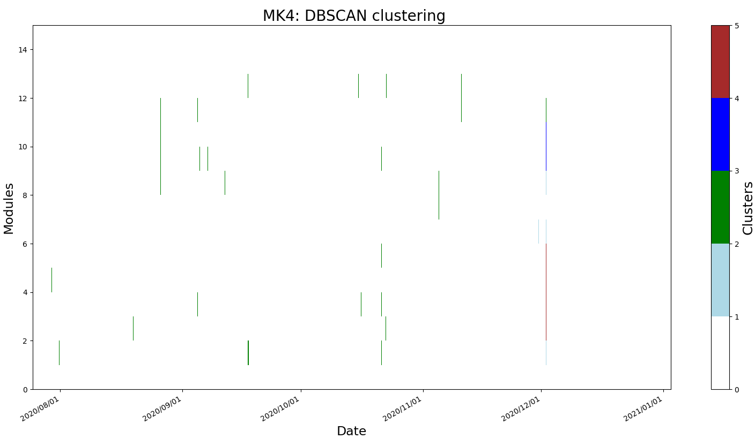
Identifying non-furnace faults using DBSCAN
Tunning the DBSCAN parameters
N clusters: 3 N noise points: 69
Noise
FD < 0.9

Slide 34

Identifying non-furnace faults using DBSCAN
We obtain a signal that looks like what we wanted to achieve.

Slide 35
Identifying non-furnace faults using DBSCAN

Slide 36
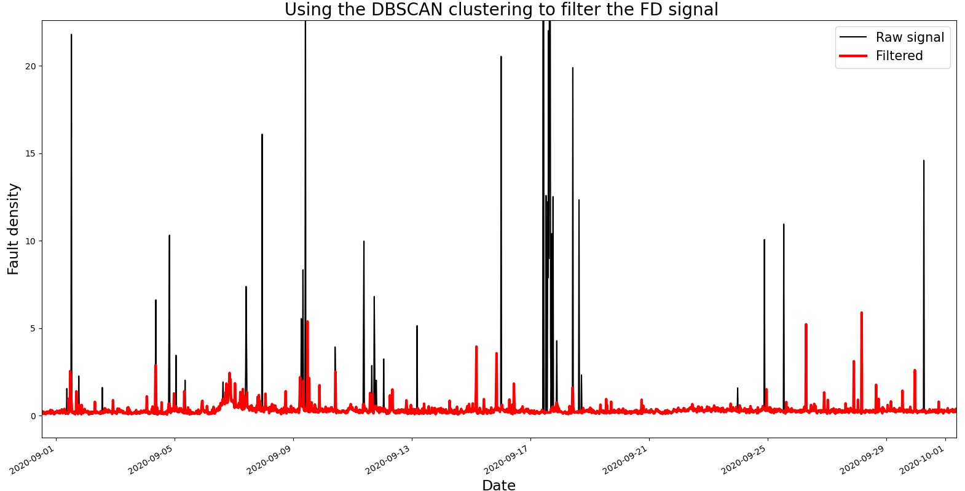
Identifying non-furnace faults using DBSCAN

Slide 37
Thank you for your attention. ANY QUESTIONS?

